Slide 1
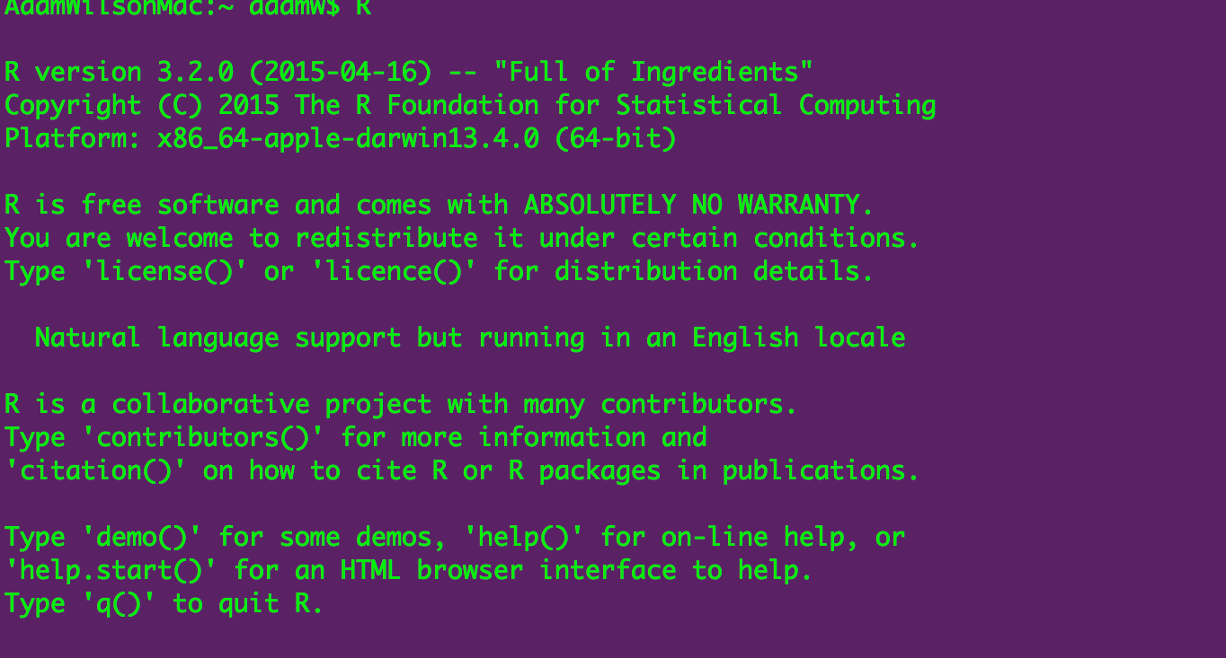
Spatial environmental data analysis with R GEO 503

Slide 2
Agenda
Quick introductory presentation
Hands-on exercises
adamwilson.us/RDataScience
Please interrupt!

Slide 3
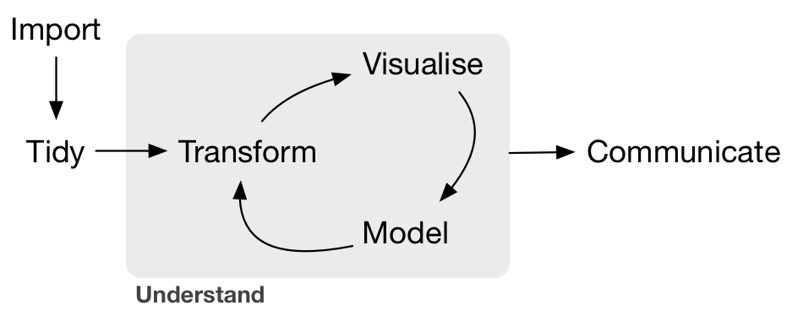
Data Science?
--Grolemund & Wickham, R for Data Science, O'Reilly 2016

Slide 4
On programming
“Programming ought to be regarded as an integral part of effective and responsible data analysis”
- Venables and Ripley. 1999. S Programming
You can figure it out!

Slide 5
A table ‘named’ iris.
Row | Sepal.Length | Sepal.Width | Petal.Length | Petal.Width | Species
1 | 5.1 | 3.5 | 1.4 | 0.2 | setosa
2 | 4.9 | 3 | 1.4 | 0.2 | setosa
3 | 4.7 | 3.2 | 1.3 | 0.2 | setosa
4 | 4.6 | 3.1 | 1.5 | 0.2 | setosa
5 | 5 | 3.6 | 1.4 | 0.2 | setosa
mean(iris$Sepal.Width)
filter(iris, Sepal.Length<4.9)
iris$Sepal.Length + iris$Petal.Length

Slide 6
It won’t take long before you can ‘read’ this…
space.only <- gam(present~s(X_CEN, Y_CEN), data=finch@data, family="binomial") preds.space.only <- as.numeric(predict(space.only, type="response")) resid.space.only <- residuals(space.only) finch$space=as.numeric(predict(space.only,type="terms"))
ggplot(finch@data, aes(x=x,y=y,z=space, map_id = id)) + geom_map(aes(fill = space), map = pfinch)+ geom_point(aes(col=as.logical(present)))+ expand_limits(x = pfinch$long, y = pfinch$lat)+ scale_fill_gradientn(colours= c("darkblue","blue","grey","yellow","orange","red"))+ scale_color_manual(values= c("transparent","black"),name="Present")+ coord_equal()

Slide 7
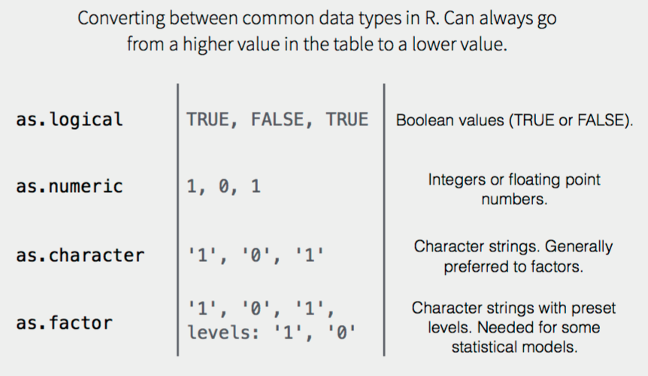
Data Types

Slide 8
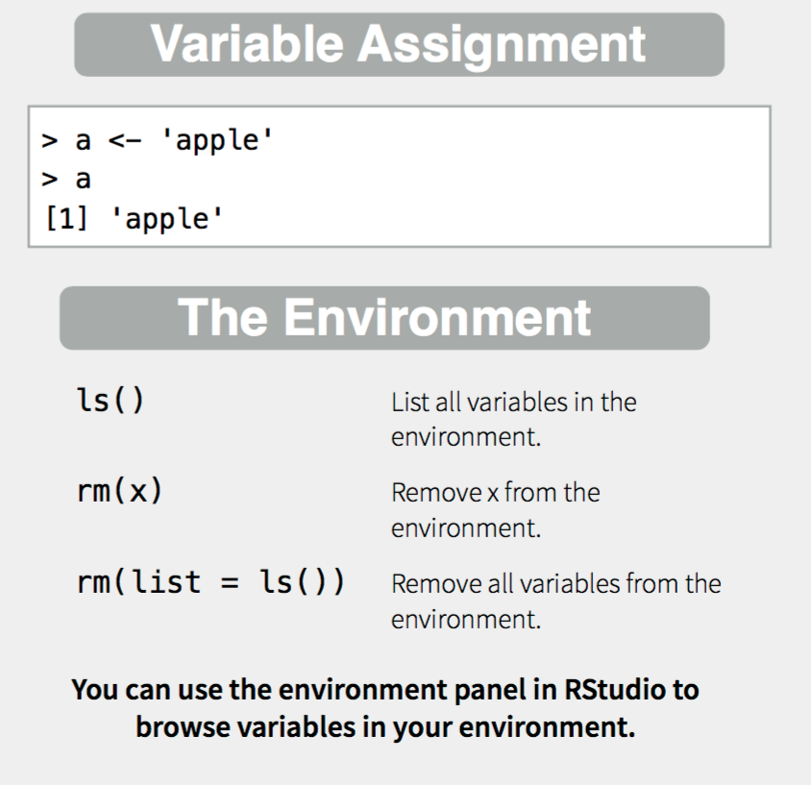
Creating and destroying objects

Slide 9
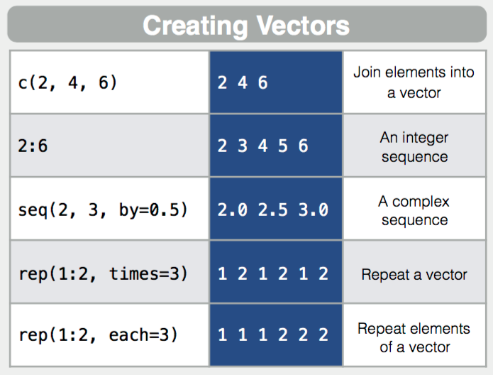
Vectors

Slide 10
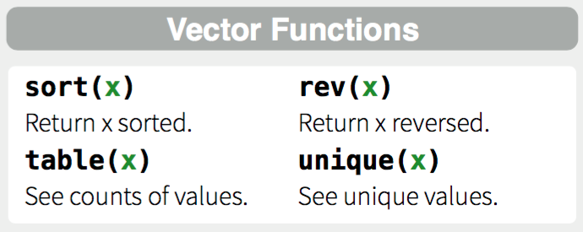
More with dplyr later

Slide 11
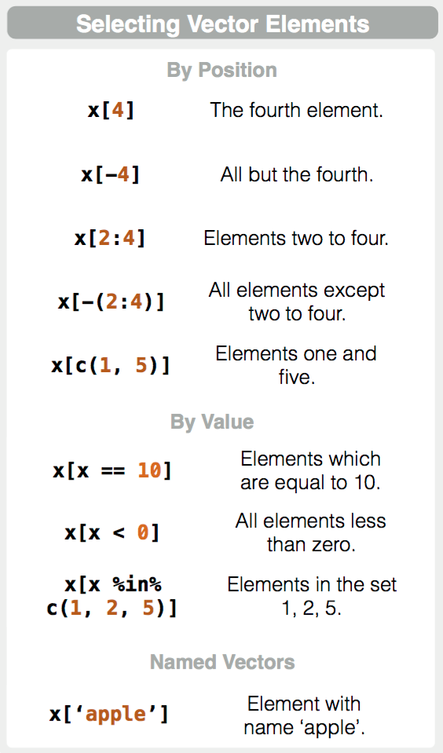

Slide 12
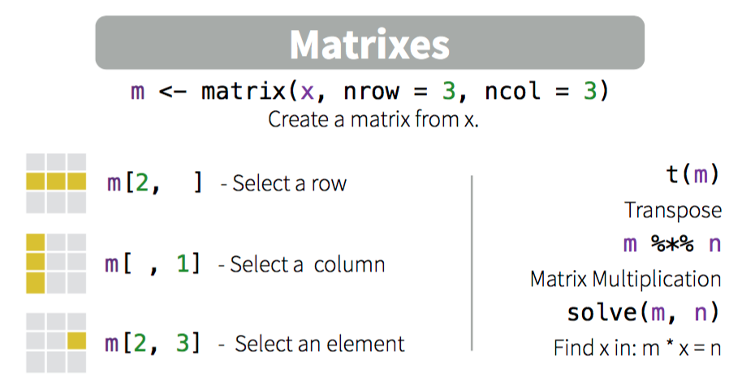
Working with Matrixes (matrices)

Slide 13
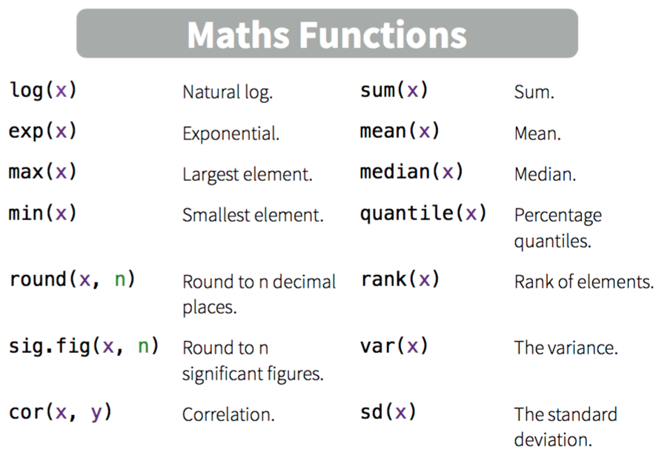
Working with Matrixes

Slide 14
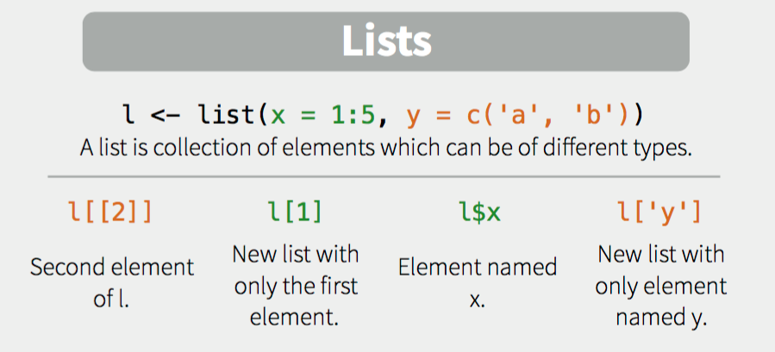

Slide 15
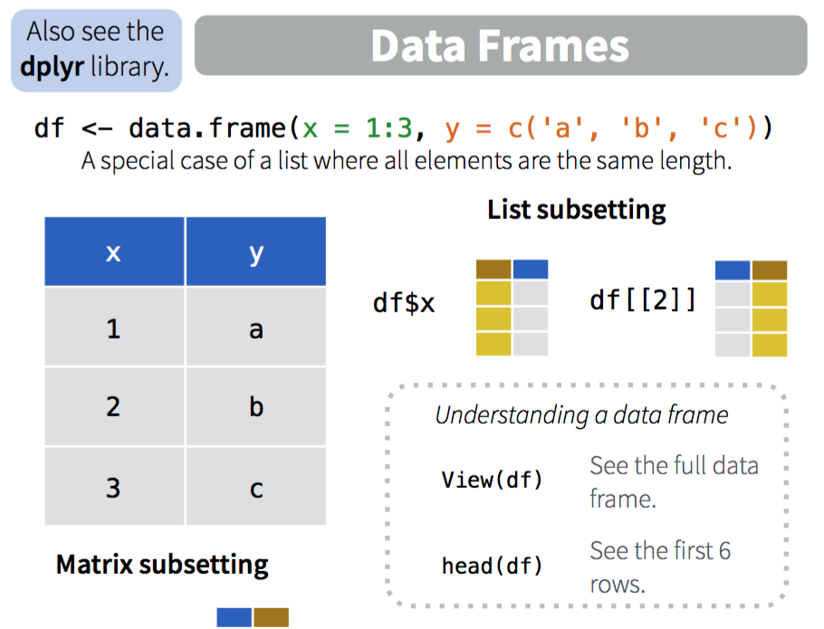

Slide 16

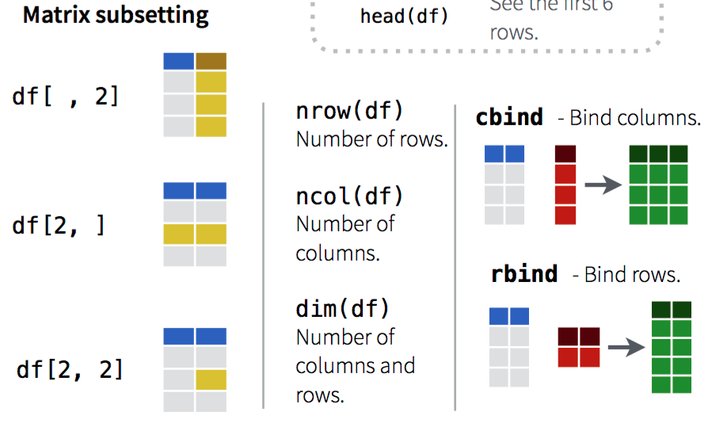

Slide 17
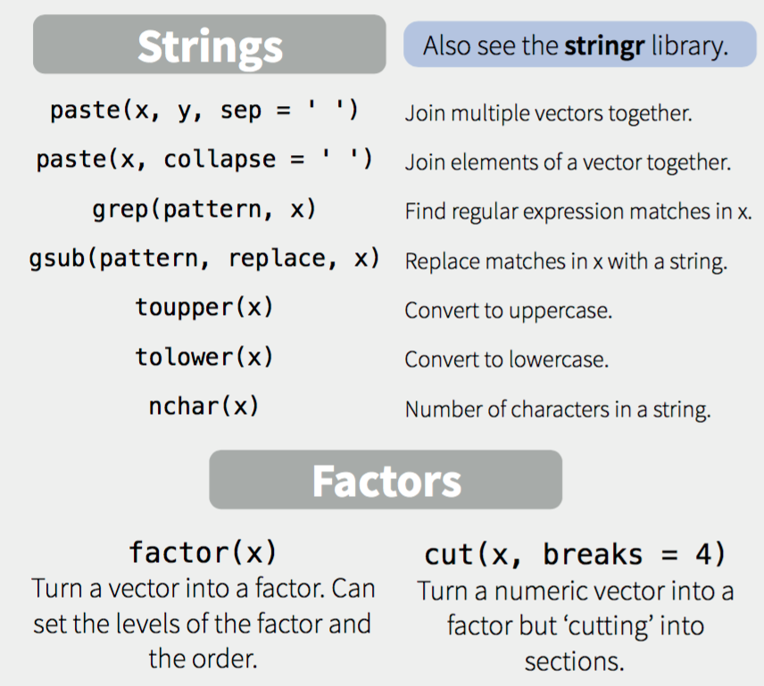

Slide 18
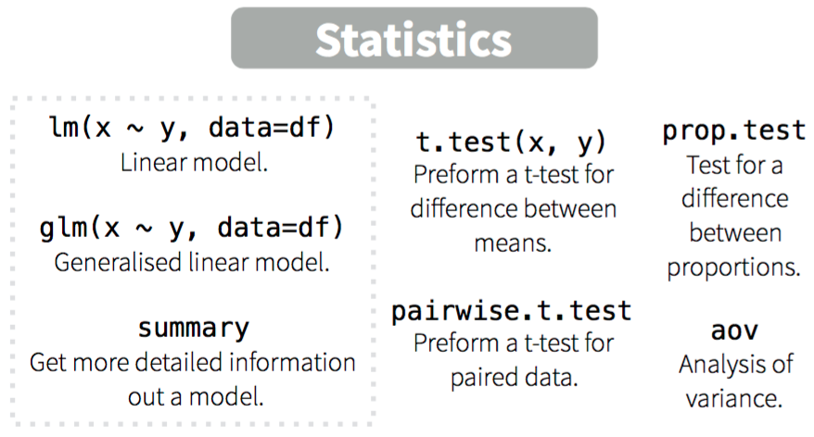

Slide 19
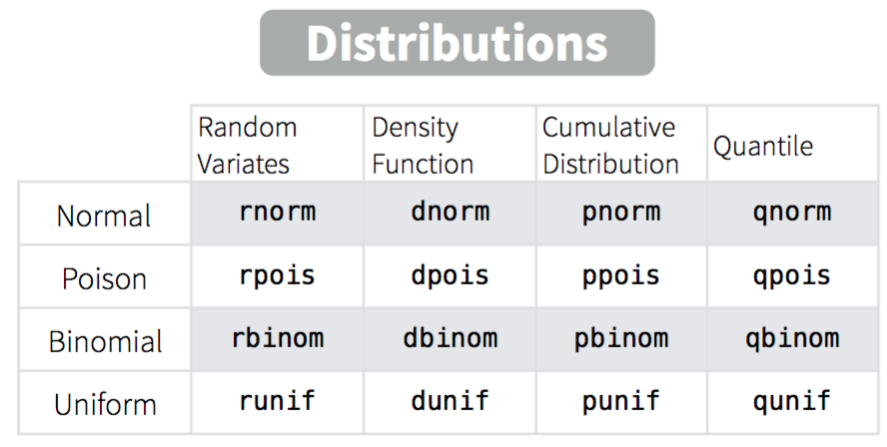

Slide 20
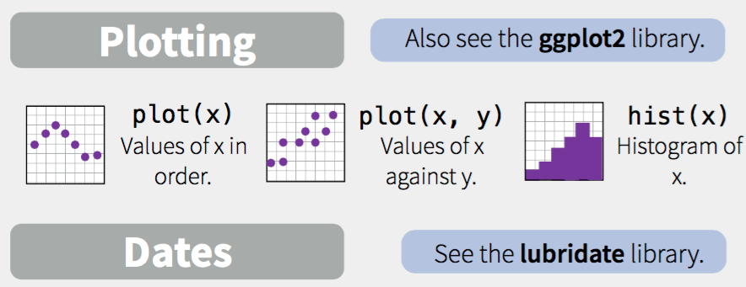

Slide 21
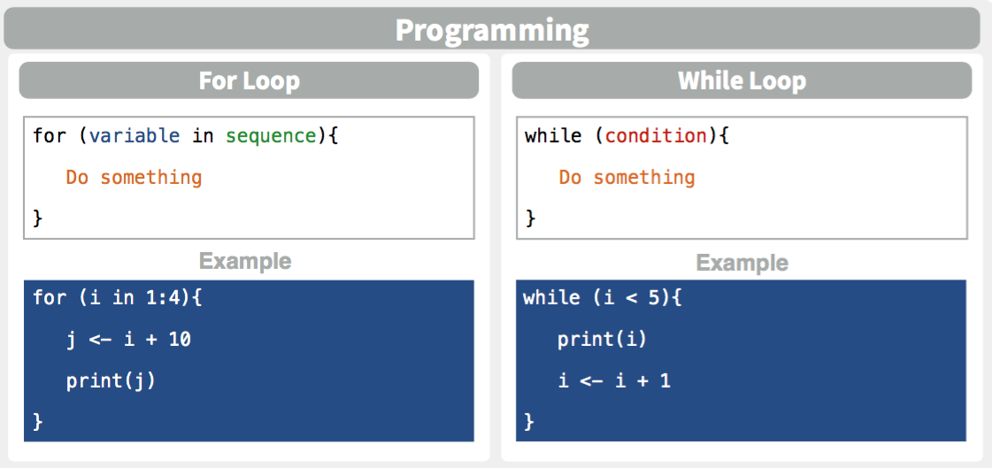

Slide 22
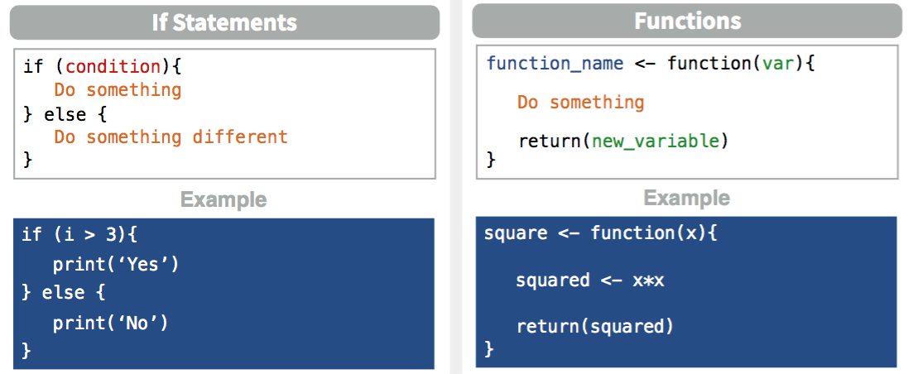
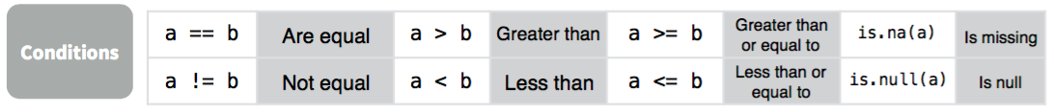
If statements and functions

Slide 23
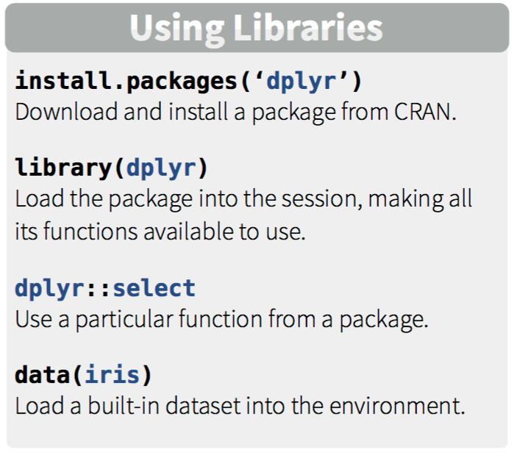
Libraries

Slide 24
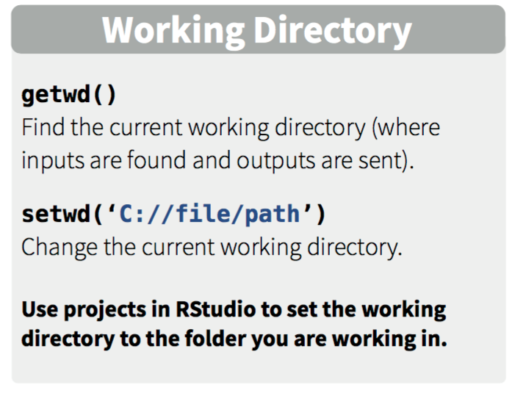
Working Directory

Slide 25
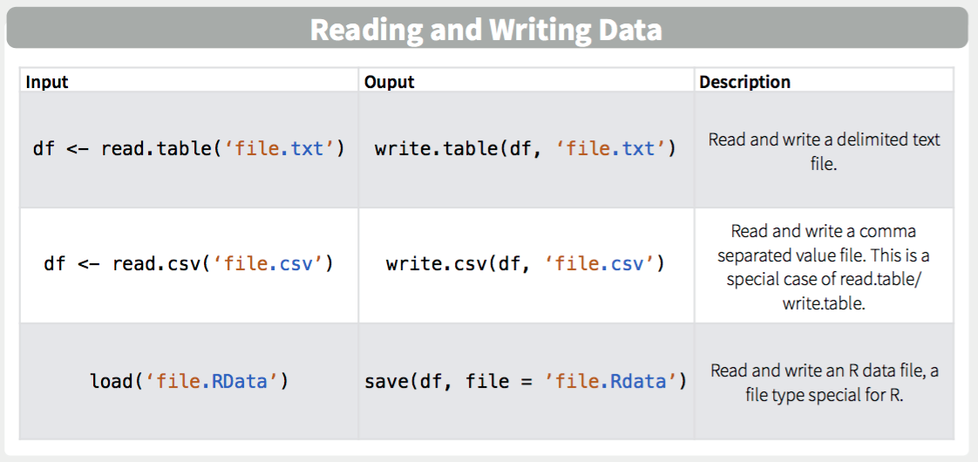

Slide 26
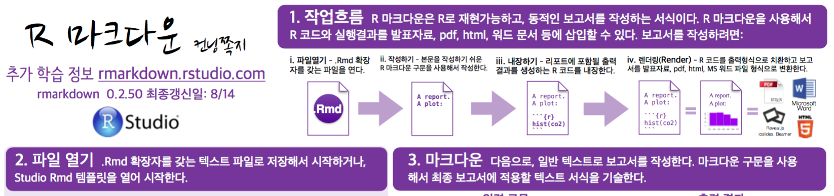
Cheatsheets
Check out https://www.rstudio.com/resources/cheatsheets/ for more cheat sheets summarizing R and related projects…
RMarkdown Cheatsheet in Korean

Slide 27
Homework Notes

Slide 28
Homeworks
Homework #1 Due Next Monday before class (8:30AM)
2 Attempts for First Homework
’Example’ Homework available
Find it in UBLearns

Slide 29
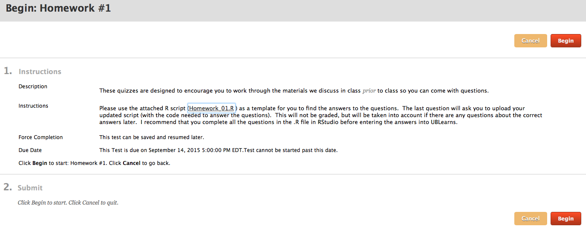
Homework submitted in UBlearns
Working collaboratively is encouraged but you are responsible for developing your own code to answer the questions:
Acceptable: “which functions did you use to answer #4?”
Unacceptable:“please email me your code for #4.”

Slide 30
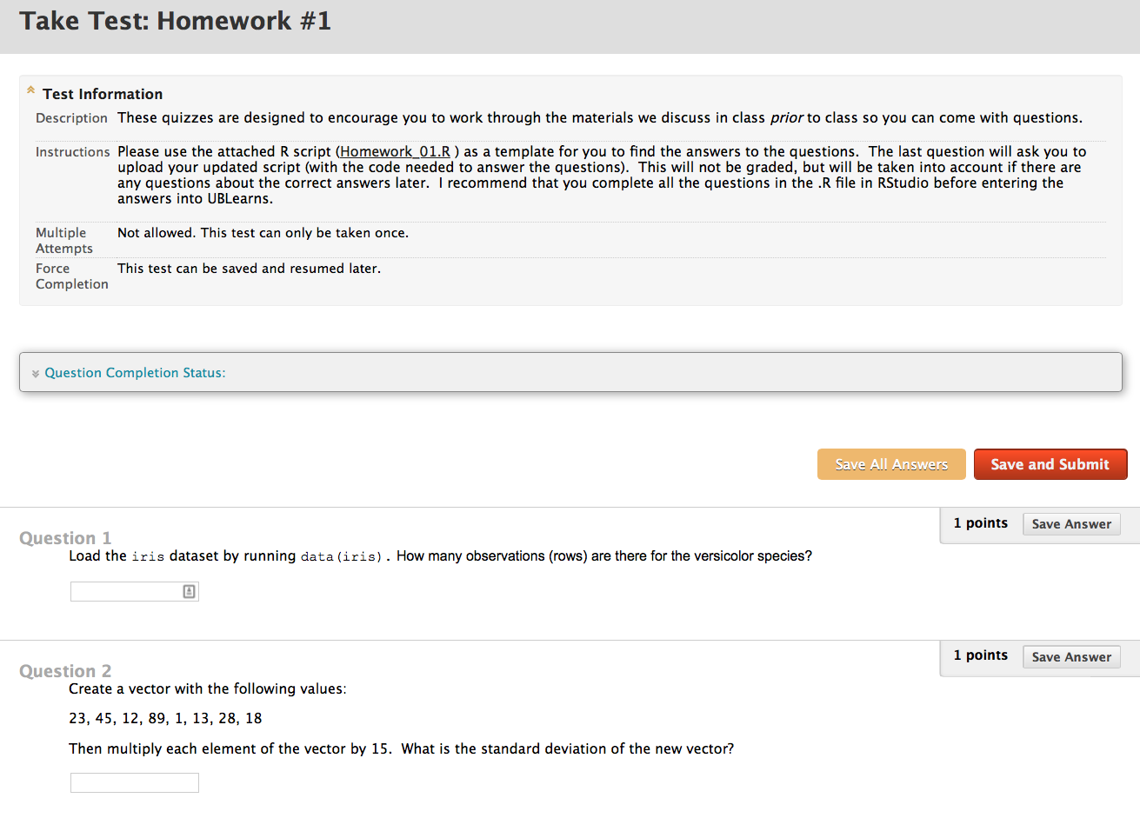
Homework format

Slide 31
R Introduction
Please interrupt!

Slide 32
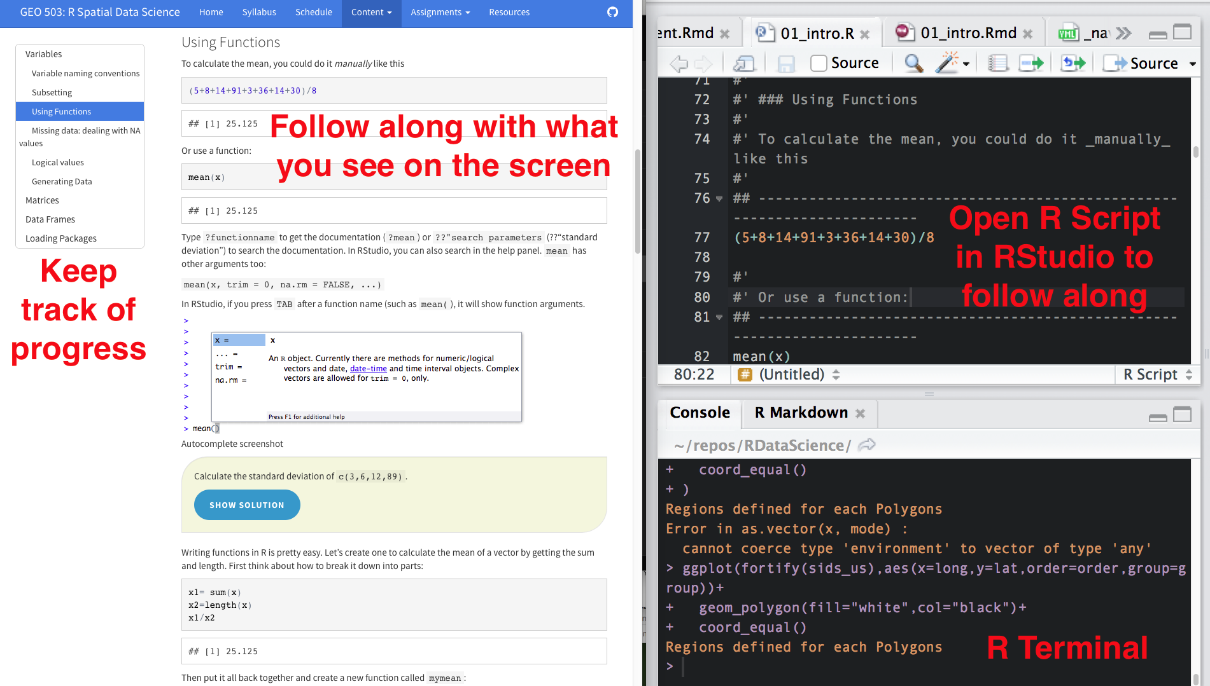
Set up your screen
On the screen

Slide 33
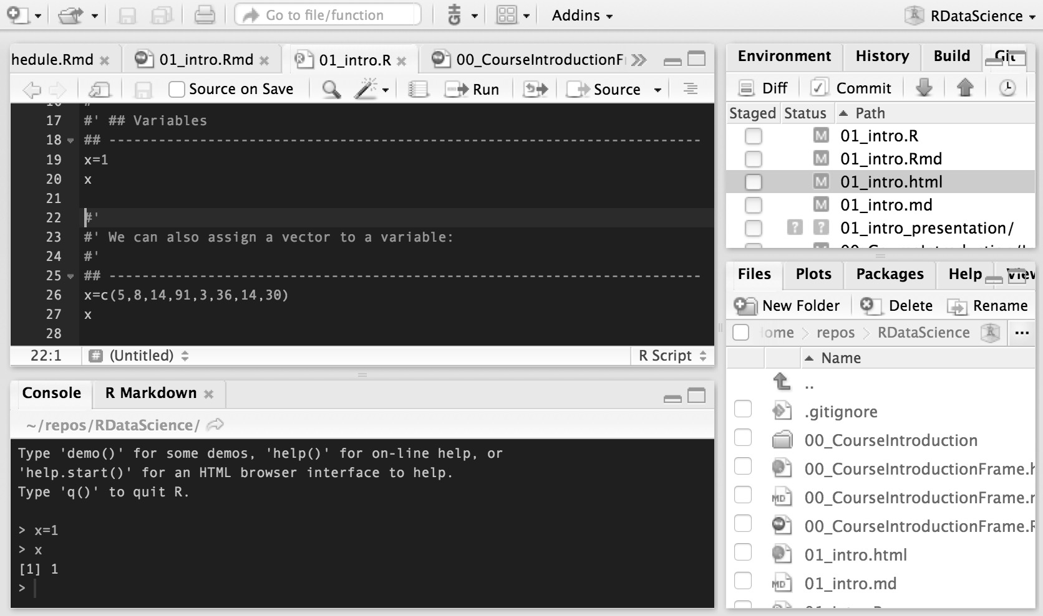
Take time to learn efficient flows…
Write code here
Ctrl (or command)-R will run a line (or whatever is highlighted)
Outputs appear here, did you get what you wanted?

Slide 34
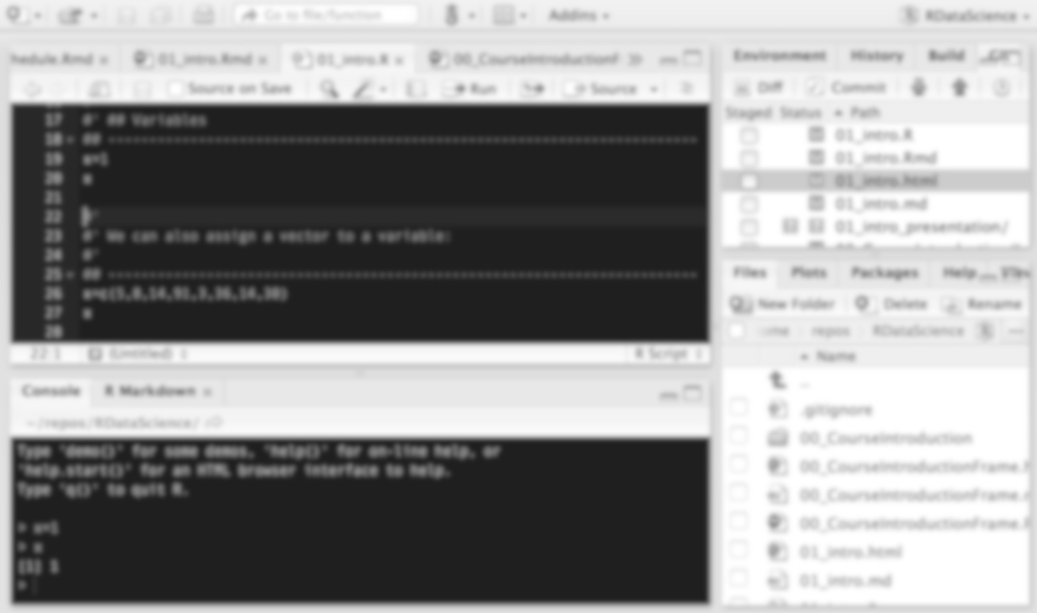
Take time to learn efficient flows…
Your code is your product!
Your outputs are ephemeral

Slide 35
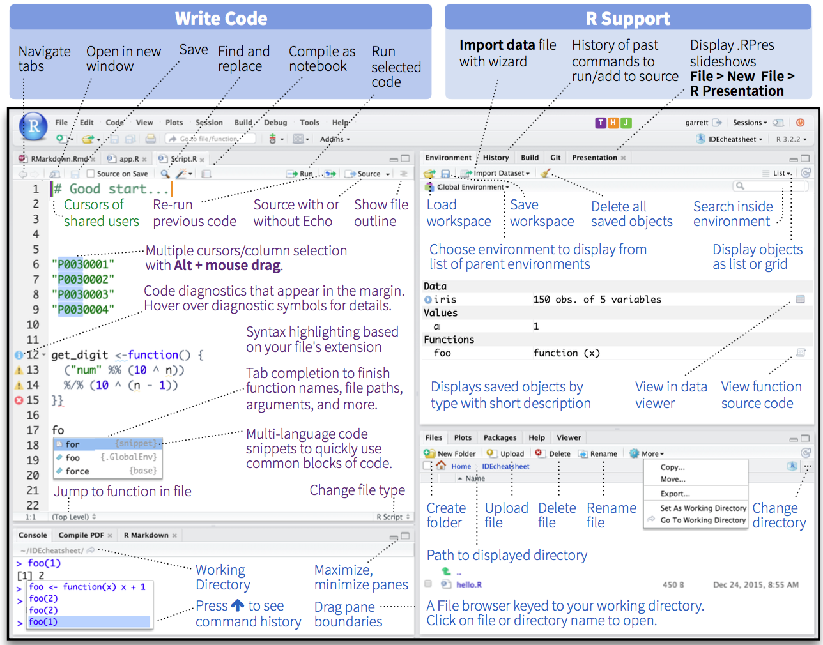

Slide 36
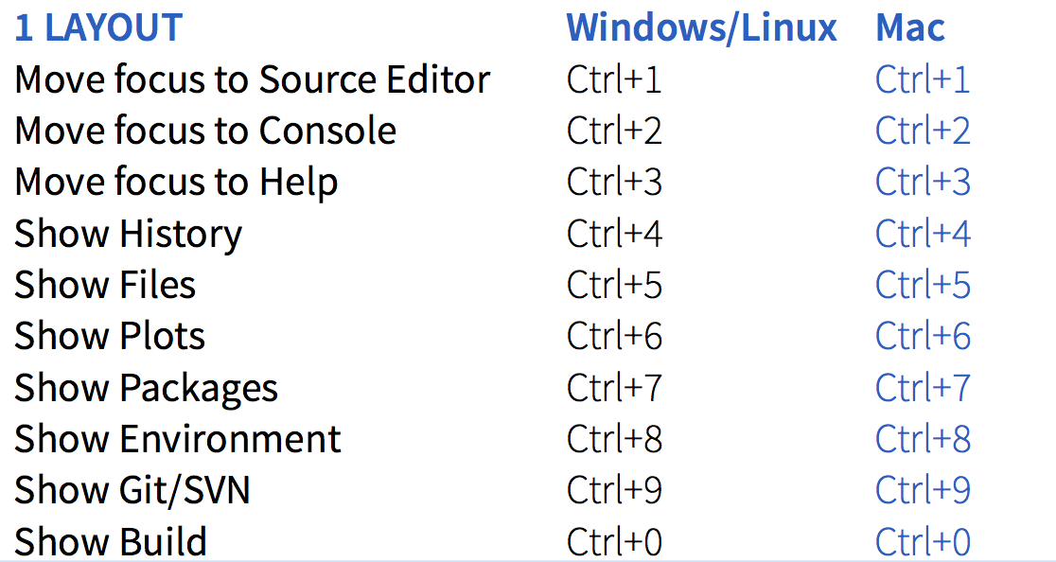
RStudio Keyboard shortcuts for (nearly) everything
Focus on use of ctrl (command) -R for sending code

